Slide 1
Introduction to Programming
Lecture 5

Slide 2
Agenda
Memory Addresses
Reference variables
Pointers

Slide 3
Memory Addresses

Slide 4
Memory Addresses
The memory address is the location where the variable is stored in the computer.
When we assign a value to the variable, it is stored in memory address.
Memory
0
1
2
3
|
|
|
4096
Memory cells
Each cell has a cell number called Memory Address

Slide 5

Memory Addresses
Every value inside the computer is binary even the memory address
Memory
0
1
2
3
|
|
|
4096
Memory cells
Memory address could be 32 bits or 64 bits or more.
It usually represented in hexadecimal numbers
Decimal is base 10
Binary is base 2
Hexadecimal is base 16

Slide 6

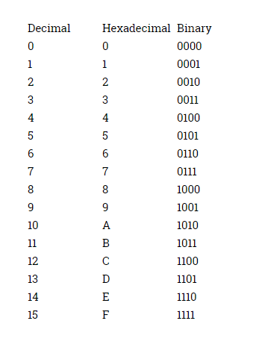
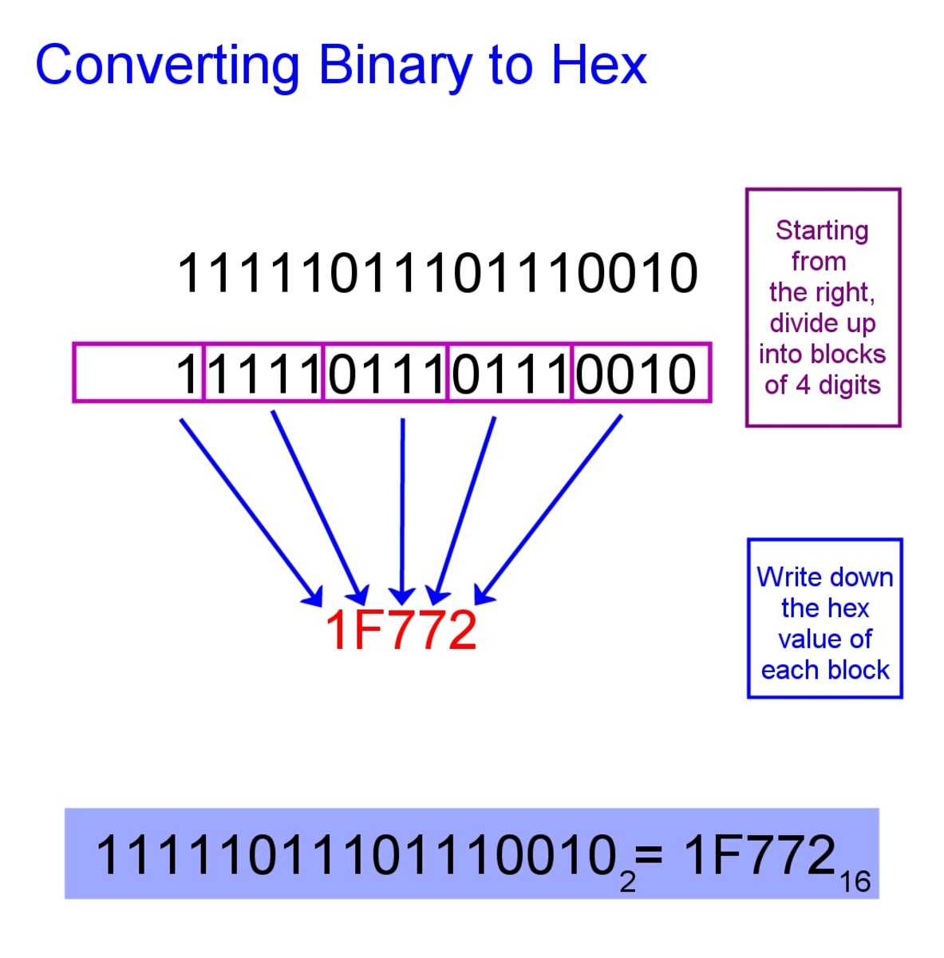
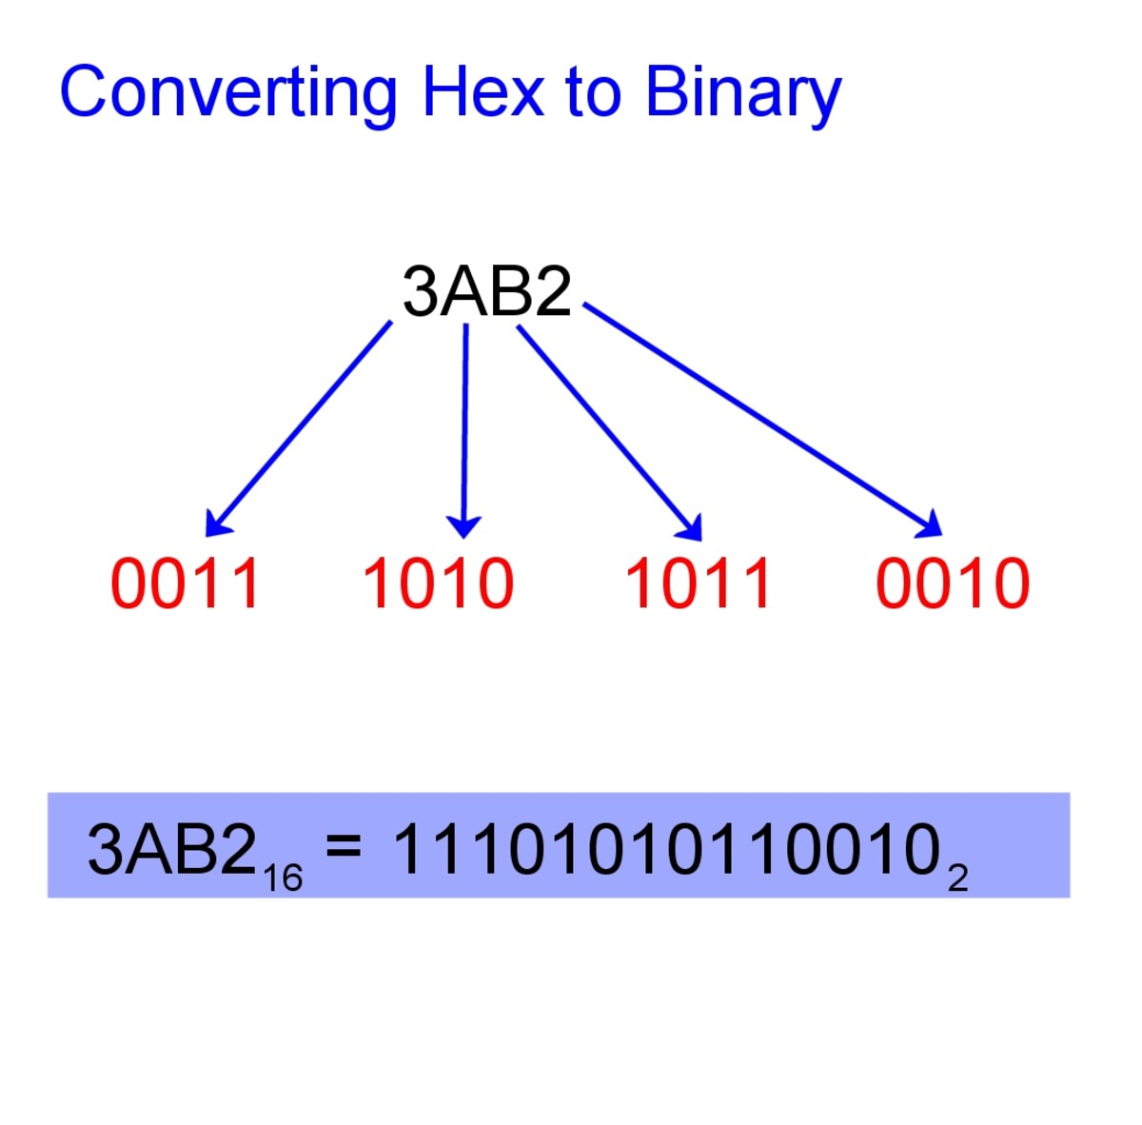
Memory Addresses
Each 4 bits in binary is converted to 1 hexadecimal digit

Slide 7
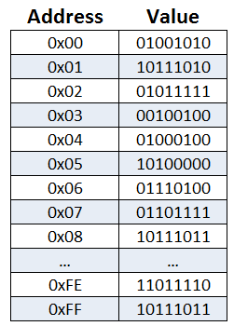
Memory Addresses
All that we care about in our module to know that:
Memory addresses are represented in hexadecimal.
If the computer wants to tell you that the number is hexadecimal:
0x is added before the hexadecimal number

Slide 8
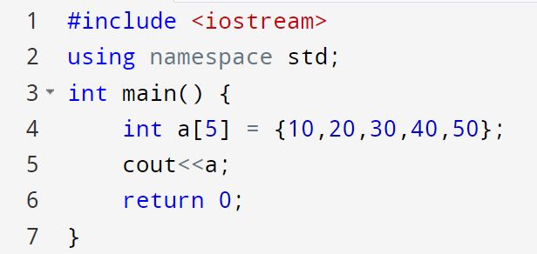



Memory Address
The memory address of the first element of the array in hexadecimal

Slide 9
Reference Variable

Slide 10


Reference Variable
A reference variable refers to the memory address of another variable.
A reference variable is created with the & operator
Memory
Pizza
string food = "Pizza"; string &meal = food; cout << food << endl; cout << meal << endl;
food
meal
You need to initialize the reference during declaration, or you will get an Error
String &meal ; //Error

Slide 11
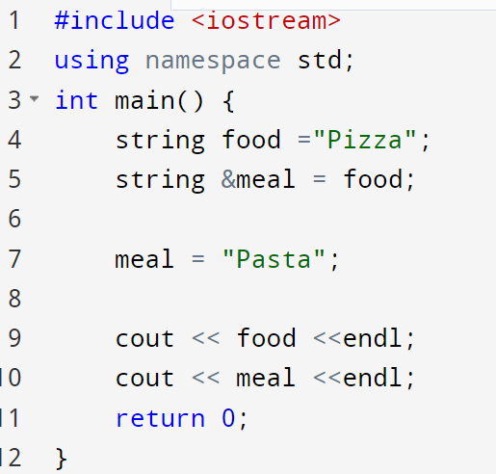


Reference Variable
Memory
Pasta
food
meal

Slide 12

Reference Variable
string food = "Pizza"; string &meal = food;
string lunch = "Burger"; &meal = lunch
Error
A reference can't be reseated or made to refer to another variable after it's been formed.

Slide 13
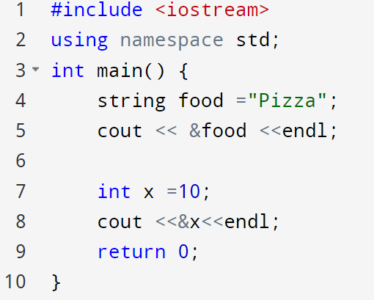



References
refre
Reference of food variable
Reference of x variable

Slide 14
Pointers

Slide 15
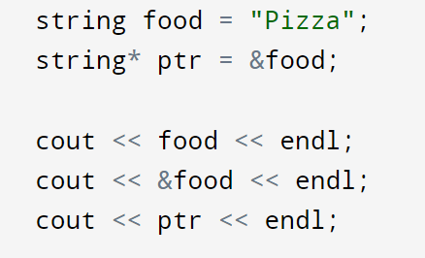
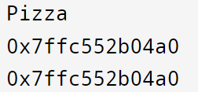


A Pointer
A pointer is a variable that stores the memory address as its value.
A pointer variable points to a data type (e.g. int or string) and is created with the * operator. The address of the variable you are working with is assigned to the pointer.
Same reference

Slide 16
A Pointer
There are three ways to declare pointer variables
string* ptr; string *ptr; string * ptr;
The type of the pointer has to match the type of the variable you're working with.
string food = "Pizza";
string* ptr = &food;
int num = 10;
int* iPtr = &num;

Slide 17
Why pointers?
References and Pointers are important in C++ because they give you the ability to manipulate the data in the computer's memory, which can reduce the code and improve the performance.
Programming languages like Java and Python don’t directly have pointers.

Slide 18
Normal variables and Pointers declarations
int *p1, *p2, i;
// p1 and p2 are int pointers. i is an int
// p1 is a int pointer, p2 and i are int
int * p1, p2, i;
// p1 and p2 are int pointers, i is an int
int * p1, * p2, i;

Slide 19
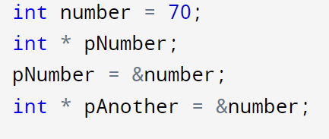

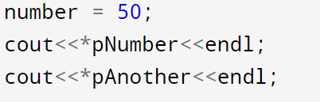



Deference Operator
You don’t need to initialize the pointer during declaration
The pointer variable to get the memory address of a variable (used together with & reference operator)
Same reference
We can also use the pointer to get the value of the variable, by using the * operator (the dereference operator)
The * sign does two different things in the code:
When used in declaration (int* ptr), it creates a pointer variable.
When not used in declaration, it acts as a dereference operator.

Slide 20

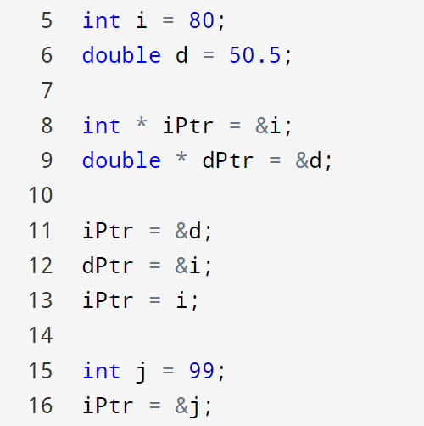

Example
ERROR, cannot hold address of different type
ERROR, cannot hold address of different type
ERROR, pointer holds the address of an int, NOT int value

Slide 21
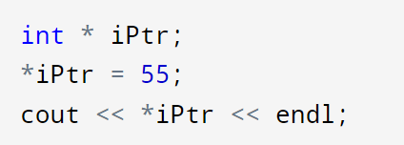
Uninitialized Pointers
The pointer *iPtr = 55 was declared without valid initialization. It is pointing to an invalid memory location.
You need to initialize a pointer by assigning it a valid address.
Most of the compilers do not signal an error or a warning for an uninitialized pointer. However, it causes the program to collapse when this pointer is used.

Slide 22
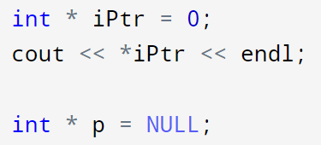

Null pointers
You can initialize a pointer to 0 or NULL. It points to nothing.
It is called a null pointer. Dereferencing a null pointer (*p) causes an Error.
Initializing a pointer to null during declaration is a good software engineering practice.
Declare an int pointer, and initialize the pointer to point to nothing
ERROR
Also declares a NULL pointer points to nothing
In newer version in C++

Slide 23
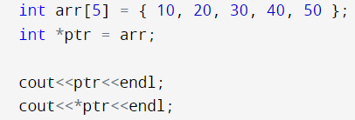

Pointers with arrays
Memory
10
20
30
40
50
arr
ptr

Slide 24
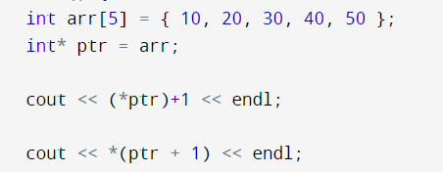


Pointers with arrays
Memory
10
20
30
40
50
arr
ptr
*(ptr + 1) is equivalent to arr[1];
*(ptr + 2) is equivalent to arr[2];
*(ptr + 3) is equivalent to arr[3];
*(ptr + 4) is equivalent to arr[4];

Slide 25
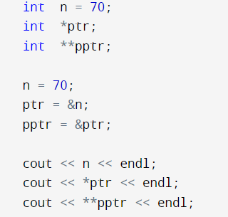



Pointer to a pointer
When we define a pointer to a pointer, the first pointer contains the address of the second pointer, which points to the location that contains the actual value.
pptr
at address 0x7ffc9256abcd
ptr at address 0x7ffc9256bcf8
n at address
0x7ffc9256bd04
0x7ffc9256bcf8
0x7ffc9256bd04
70

Slide 26
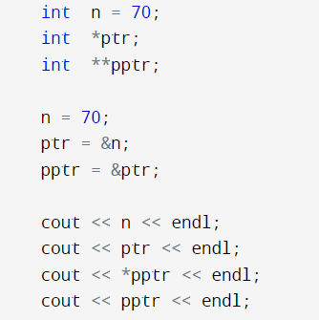
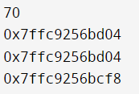
Pointer to a pointer
When we define a pointer to a pointer, the first pointer contains the address of the second pointer, which points to the location that contains the actual value.
pptr
at address 0x7ffc9256abcd
ptr at address 0x7ffc9256bcf8
n at address
0x7ffc9256bd04
0x7ffc9256bcf8
0x7ffc9256bd04
70

Slide 27
References versus pointers
References
Pointers
A reference can't be reseated or made to refer to another variable after it's been formed.
NULL references are not allowed.
A reference must be initialized at the moment of declaration.
A pointer can be reseated or made to refer to another variable after it's been formed.
NULL pointers are allowed.
It is not a must that a pointer is initialized at the moment of declaration.

Slide 28

Thank You

